Slide 1


Git and GitHub Course
Part B, GitHub

Slide 2
Part B, GitHub
GitHub is an online Source Control Repository designed to work with Git.
Remember: Git is a local source control versioning system that can work locally
or in conjunction with GitHub.

Slide 3
Part B, GitHub
What are the advantages of using GitHub along with using Git?
GitHub allows a developer to share his/her code with others on the Internet.
GitHub allows for group collaboration of software development projects.
GitHub, in the least, provides a backup to your local Git Repositories on the web.

Slide 4
Part B, GitHub
In order to use GitHub, you must have setup and been using Git Version Control.
This means you have added (copied) files from your working to the staging area.
This means you have commited (moved) you staged files to your Git Repository.
Once, you have your source files in your local Git Repository, you are new ready to Push (copy) your Git Repository up into the GitHub online version control system.
The next slide will show you how to Push a Git Repository up into GitHub online.

Slide 5
Part B, GitHub
How to setup and begin using GitHub:
First, go to the GitHub website and create a GitHum user account (It is free).
The website for GitHub is: https://github.com.

Slide 6

Part B, GitHub
The website for GitHub is: https://github.com.
Signup Here!

Slide 7
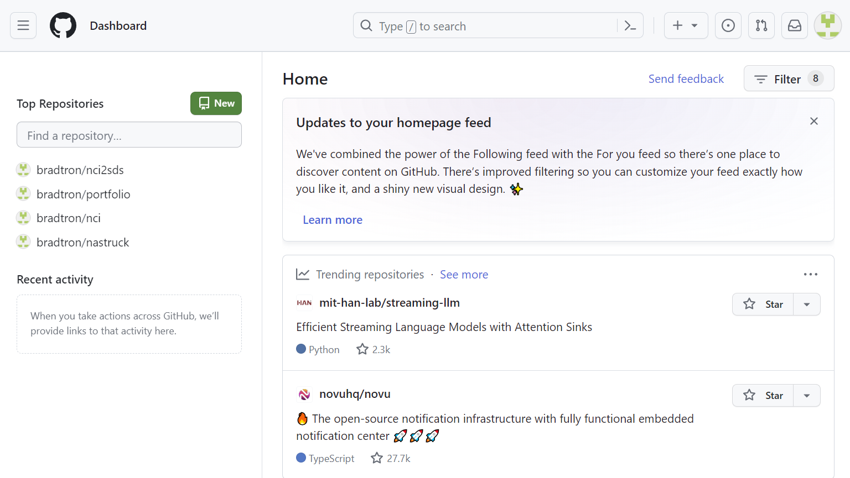
Part B, GitHub
After you login you will be on this GitHub page.
You create a new repository
with this button
Sample
Repositories
You should create your GitHub Repositories with the same names as your Git Repositories.
Create a GitHub Repository with green button with same name as your Git Repository

Slide 8
Part B, GitHub
You are now ready to create a GitHub Repository in your GitHub Account.
Press the Green Button on the GitHub Login page shown on previous slide.
You will be asked for a Repository Name. Enter your Git Repository name.
It is a good practice to name your Git and GitHum Repositories the same.
Just take all the defaults, for now, when creating your GitHub Repository.
For example: If you created a repos directory on your Windows PC Desktop,
then you created a project1 Git Repository in the Desktop repos folder, then
create a GitHun Repository with the same name: project1.
You are now ready to Push (copy) your Git Repository up to your new GitHub Repo.

Slide 9
Part B, GitHub
GitHub
Here is where you need to capture a GitHub Repo Path information.
This GitHub Repo Path Is needed before you can Push a Git Repo up to GitHub.
So, how to you capture your new GitHub Repo Path for use with Git?
Go to the GitHub signin page where your GitHub Repositories are located.
Click on the GitHub Repository on the left that you want to upload to,.
When the Repository Page comes up, click on the Green Code Button.
Go to the URL Link windows directly below and click the copy button on right.
You have now captured the GitHub Repository URL for this GitHub Repo.
Note: See the next two slides to see examples of how to capture a GitHub Repo URL.

Slide 10
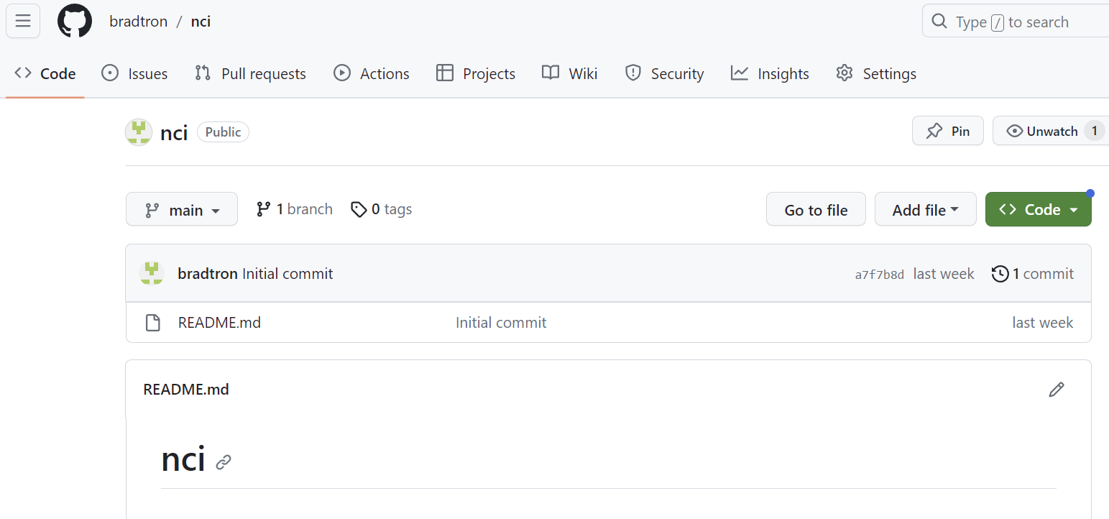
Part B, GitHub
GitHub
Click here
To open a
Window to
The GitHub
Repo URL.

Slide 11
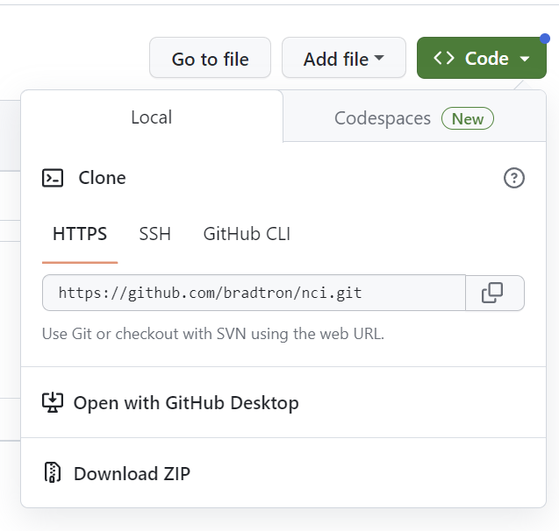
Part B, GitHub
GitHub
Click here to capture the repository URL.
You will use this URL over in Git to upload to this GitHub Repo,
Note: You can copy this GitHub Repo URL to a file or keep it in your Windows buffer.

Slide 12
Part B, GitHub
GitHub
Now, go back to your PC Command Prompt and prepare to upload a Git Reo to GitHub.
First it would be nice to be able to save the GitHub Repo URL to a variable in Git.
Here is how that is done, so you don’t have to remember your GitHub Repo URL.
You should be back in your PC Command Prompt and be in the correct Git Repository.
Enter the following command at the Command Prompt…
> git remote set-url origin https://github.com/GitUser0422/demo.git
Note: The GitHub Repo URL you enter will look different than what you see here.
So, what did you just do? You just associated the GitHub Repo URL with origin.
This means you no longer have to remember the GitHub Repo URL, use origin instead,.
Note: On the next slide you will see how to transfer your Git Repo up to your GitHub Repo.

Slide 13
Part B, GitHub
GitHub
Ok, you are back at the PC Command Prompt in your Get Repository directory.
You have loaded your GitHub Repo URL into the variable origin, so we will use origin now.
You need to make sure you are in your Git Repository Directory that matches GitHub Repo.
git push -u origin master
Note: origin is an alias for your GitHub Repository URL, which you setup previously.
master is the default name for the main branch of your Git and GitHub Repositories.
Note2: push can take a few seconds or more, because you are pushing your Git Repository files from you Local Git Repository up over the Internet to your GitHub Repository.
Note3: pull is the complement to push, which will be covered later in this course.

Slide 14
Part B, GitHub
GitHub
Congratulations! If your push command worked you have transferred your first Git Repository up to your corresponding GitHub Repository on the GitHub Web Site.

